Slide 1

Yuchen Song
2023/5/17
CSECON206 _Final
Modified Chicken Game under a Spy Operation Scenario

Slide 2
01
Background & Motivation

Slide 3
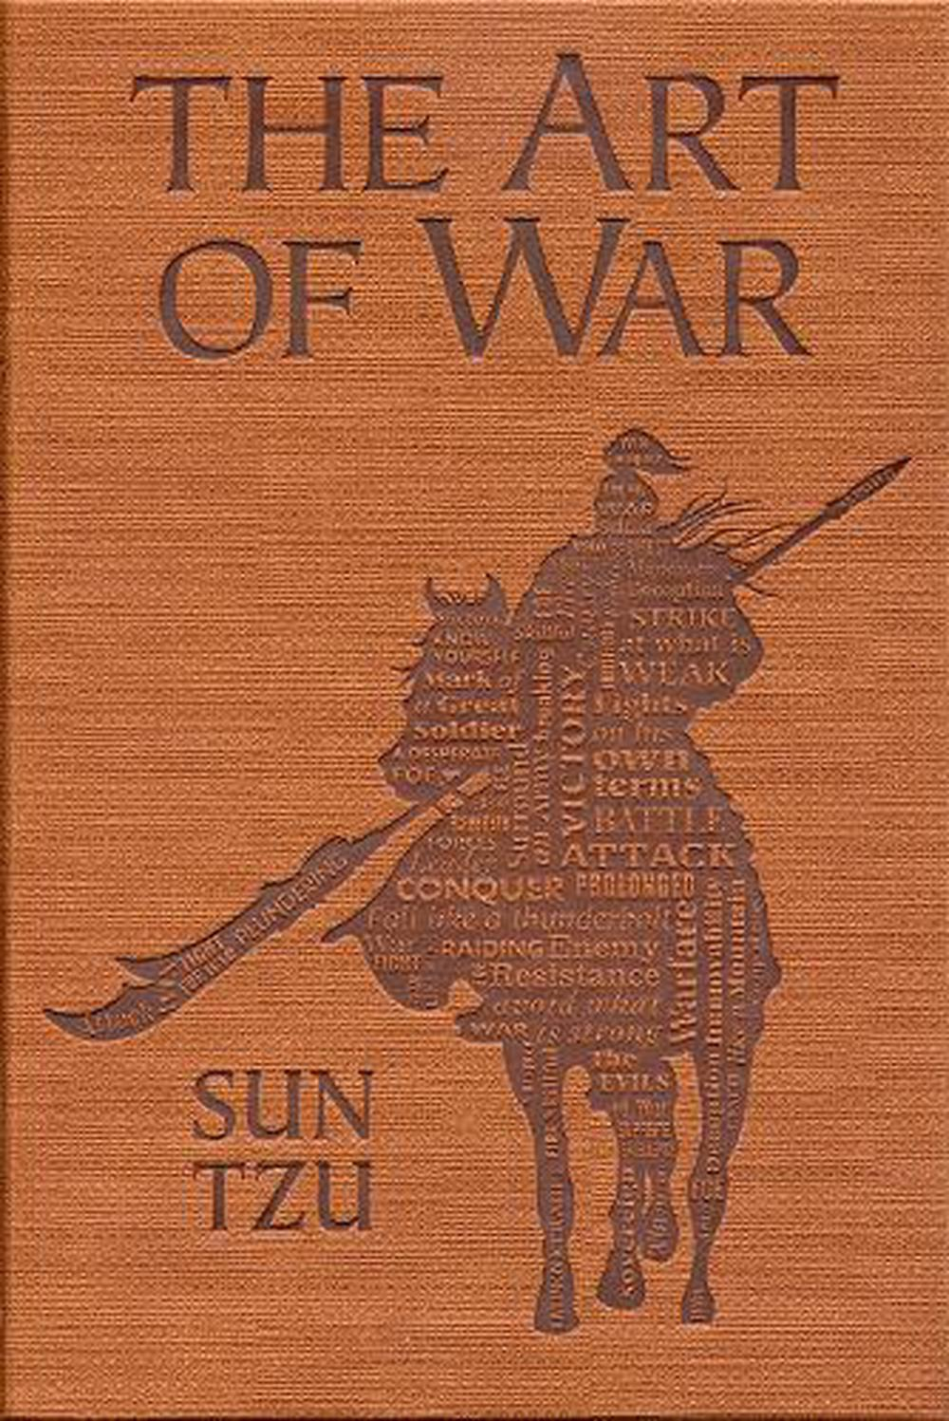
Literature Review
The first piece of literature is “A Game-Theoretic Interpretation of Sun Tzu’s The Art of War”. The author compares the game theory with the strategy in Sun Tzu's Art of War, to study whether Sun Tzu's thoughts have covered the content of game theory, its limitation, and the strategy beyond the scope of game theory. By detailed analysis and comparison, the author points out that Sun Tzu's thoughts about the secret agent in The Art of War are complex and not in the existing concepts of game theory.

Slide 4
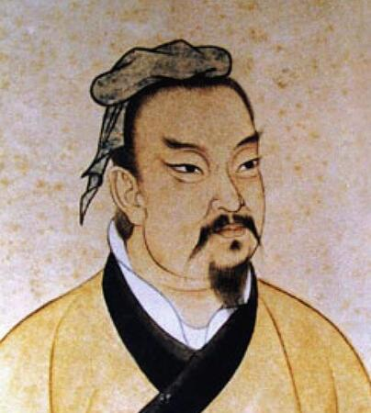
Literature Review
The second piece of literature is the Art of War. In the book, many strategies mainly characterized by flexibility, deception, and knowing the opponent’s information are proposed.
Among them, some points regarding secret agencies are beyond the discussion of game theory.
Sun Tzu discusses secret agents: “Secret operations are essential in war; upon them, the army relies on to make its every move.” These contents inspire the research in this paper.
Sun Tzu

Slide 5
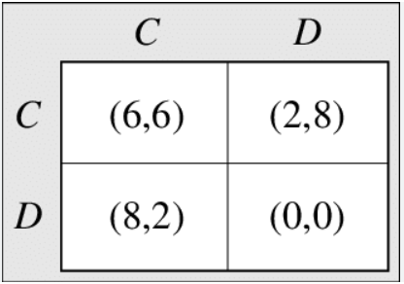
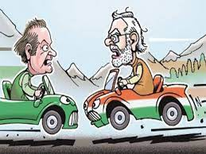
Literature Review
In the paper “ The Game of Chicken”, the authors first create the Chicken Game with the research purpose of simulating brinksmanship and appeasement, which are famous political concepts.
Chicken Game is a model of conflict between risk-taking and risk-avoidance of two players. One of the classical game scenarios is when two drivers drive toward each other, each can choose to swerve or go straight.

Slide 6

Real-world Motivation
Risk-taking behavior is common in real-world scenarios. Some can be beneficial. However, when such risk-taking involves the public good and maximizing self-interests, we need to be more cautious.
One example is environmental pollution. Some enterprises may pursue short-term self-interests without considering environmental protection and adopt irresponsible production and emission methods. Such behavior may lead to pollution that harm the whole society.
Therefore, in the pursuit of personal and corporate interests, we must take account of the public interest implications and act prudently. Also, some supervision and penalties are needed to curb irresponsible risk-taking and self-interest-maximizing behaviors.

Slide 7
02
Research Questions

Slide 8
Research questions
1
Are there some ways to force both players to be perfectly rational in the game, ultimately increasing the probability that the players will choose the Nash equilibrium?
2
How will people act in the modified Chicken Game? What are their rationales?
3
Can the additional rules in the game influence people’s decision-making and force them to avoid risk-taking choices and choose the Nash equilibrium?

Slide 9
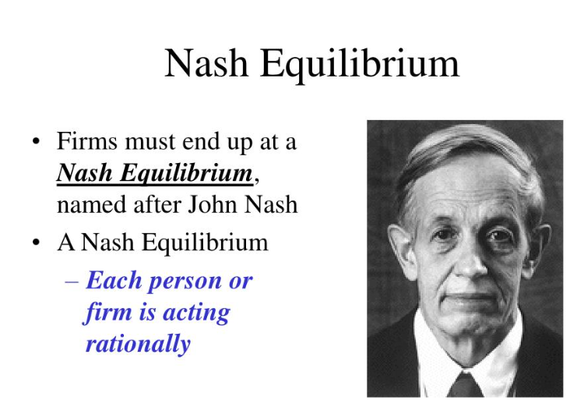
Importance of the questions
Nash equilibria are often based on the assumption that players are rational, but in real-world applications, players are sometimes willing to take risks in pursuit of maximum profit.
For example, in the Chicken Game, the solution obtained by using Nash equilibrium is that both sides choose chicken, but one side may bet that the opposite side is rational and will choose chicken. Based on this assumption, he will choose Dave to maximize his own payoff. This can result in a decrease in both the payoff of the rational players and the total payoff.

Slide 10
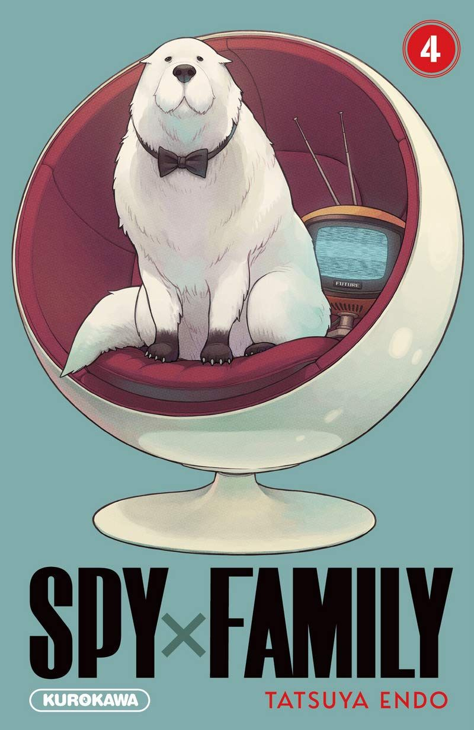
Importance of the questions
Therefore, we need to find a way to avoid irrational self-interest maximization and increase the probability that players will choose a Nash equilibrium strategy.
However, since the original rules of Chicken Game are simple, I cannot use these rules to control the selection of players. Therefore, in this article, I will modify Chicken Game based on the idea of using spies in Sun Tzu's Art of War, to study the choices of players under the new rules.

Slide 11
03
Application Scenario

Slide 12

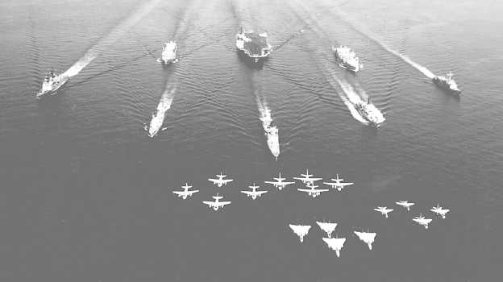
In which situation do your newly proposed game and/or solution concepts apply?
The modified Chicken Game can be applied to situations involving conflicts or interactions between two sides where risk-taking and risk-avoidance are key elements, like negtiation and military deterrence.

Slide 13

Behavioral foundation
There are several behavioral foundations of people who might be less likely to make risk-taking decisions when their strategies or choices are understood by others.
The first is social pressure. When others are aware of our decisions, we may feel pressure to conform to societal norms or expectations. The fear of being criticized by others can discourage risk-taking decisions.

Slide 14
Behavioral foundation
The second is competitive pressure. When both sides know the other’s strategies, there is a heightened sense of competition and distrust. Therefore, they will choose more carefully and choose risk-averse options.
The third is predictability. When opponents can use a spy to understand an individual’s decisions, it is easier for them to predict their next moves. This knowledge allows opponents to develop counterstrategies or take advantage of the situation, potentially leading to negative outcomes for the individual. In response, individuals may opt for safer, more conservative choices to avoid falling into predictable patterns and being exploited.

Slide 15
04
Methodology

Slide 16
Technique Assumption
1.Rationality: In the modified version, players will decide whether to use spies. If they choose to use spy, the total payoffs cannot be the one that Nash Equilibrium suggested. While, the decision is not irrational, since using a spy can detect others’ behavior and gain great advantages in the game.
2.Perfect Information: Both players have complete information about the game rules, the payoffs of each outcome, and all the strategies.

Slide 17
Behavioral Assumptions
1.Risk-Taking: Some players are assumed to be risk-seeking, and they tend to choose Dave to maximize their own payoff. Some are risk-avoidant, and they will always choose Chicken.
2.Revenge: When one player chooses to Dave, the other player is assumed to have some probability to revenge. This is an possible response to those who make unfair decisions in real-world scenarios.
3.Cost considerations: Players are assumed to consider the additional cost of spying when deciding whether to use this strategy. The rationale of this assumption is that players should weigh whether it is worth spending 1 payoff to get information, bind their opponents, and raise the probability of achieving equilibrium.

Slide 18
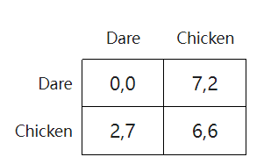
Model: Modified Chicken Game
The rules for the original Chicken Game:
Two drivers drive toward each other, each can choose to swerve or straight. If one of them chooses to swerve and the other chooses to straight, the former one will be seen as chickening out and will receive a lower payoff (2), while the latter one will receive a higher payoff (7) since he’s braver. If both choose to swerve, it will be a tie, and both receive a moderate payoff (6,6). While, if both players choose to straight, they will crash into each other, and receives a zero payoff, since they fail to avoid the risk.

Slide 19
Model: Modified Chicken Game
New rules:
Both players can choose whether to spy at the beginning of the game, if so, he will pay 1 payoff at last. And they can choose tell their opponent that they have a spy. The game has two rounds, and the total payoff is the sum of the payoff in two rounds.

Slide 20
New rules:
Both players can choose whether to spy at the beginning of the game, if so, he will pay 1 payoff at last. And they can choose tell their opponent that they have a spy. The game has two rounds, and the total payoff is the sum of the payoff in two rounds.

Slide 21
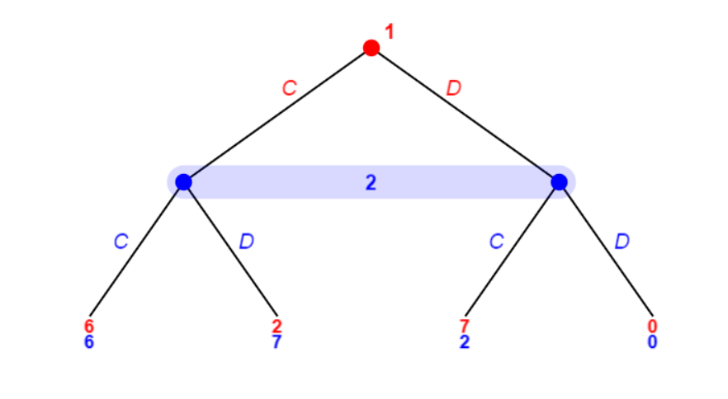
Different strategies and solution concepts
In the first case, neither side uses spies, and in the last case, there are two possible scenarios. One, both are rational, and the payoff is (12,12). Second, when one hopes to maximize the payoff in one or two rounds, the payoff is (13,8) or (14,4). Three: Both people are hoping to maximize the payoff in one or two rounds, the payoff being (9,9) or (0,0) or (7,2), or (2,7). It is worth mentioning that in the third scenario, it is possible for one party to retaliate against the other party in the second round due to the other party's selfish choice in the first round. Both (7,2) and (9,9) could be the payoff of this scenario.

Slide 22

Different strategies and solution concepts
In every other case, at least one party used a spy in at least one round. Note that if spies are used, players will let each other know about the spy operation, because if not telling their opponent, the payoff of 1 won't affect their strategy except to know the other's choice ahead of time.

Slide 23
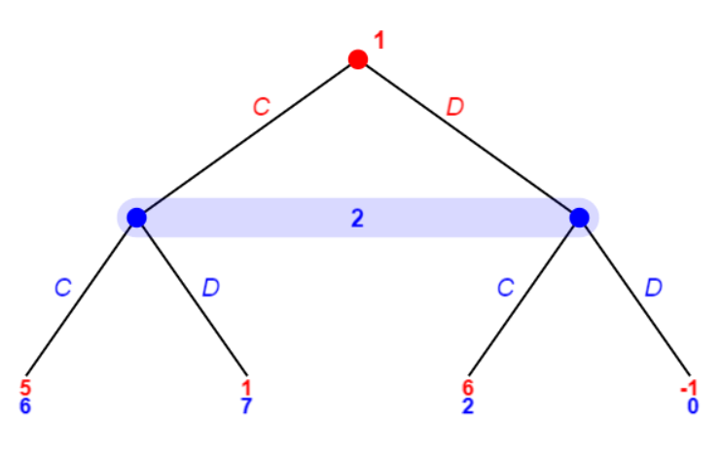
Different strategies and solution concepts
The second scenario is that one party (let's say player A) used A spy in the first round, then based on the above analysis, Player A will inform Player B, and Player B may choose to retaliate against Player A's spy because using a spy is a sign of distrust, so the result of this round is (-1, 0) or (1,7). In this case, the payoff will be less than 21, regardless of whether the two parties use spies in Round 2.

Slide 24
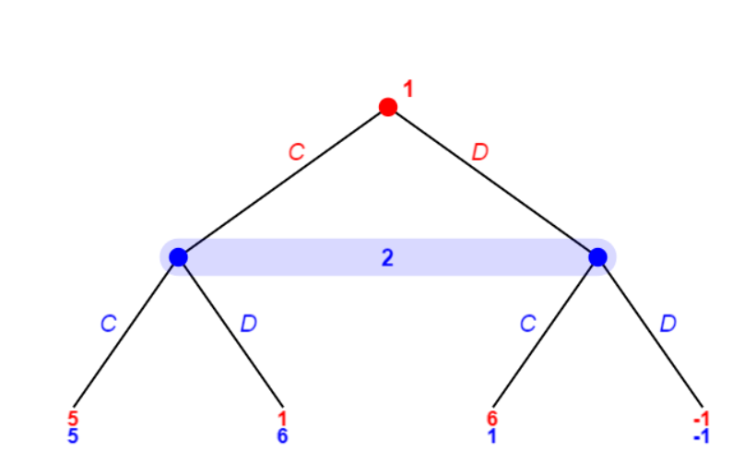
Different strategies and solution concepts
The third scenario is that both parties used spies in the first round. In these situations, where each partner's choices are being monitored by the other, and each knows that the other doesn't trust them, the chances that one of them will take a risk are greatly reduced.
Because he knows that his behavior is being monitored, and the other party will be more likely to retaliate for irrational choice.
In this case, both parties are more likely to choose to swerve when they are subject to such constraints, and the yield of this round is (5,5). In Round 2, if both sides choose to use spies, it is likely that (10,10) total payoff will be reached.

Slide 25
Different strategies and solution concepts
The third scenario is that both parties used spies in the first round. In these situations, where each partner's choices are being monitored by the other, and each knows that the other doesn't trust them, the chances that one of them will take a risk are greatly reduced.
Because he knows that his behavior is being monitored, and the other party will be more likely to retaliate for irrational choice.
In this case, both parties are more likely to choose to swerve when they are subject to such constraints, and the yield of this round is (5,5). In Round 2, if both sides choose to use spies, it is likely that (10,10) total payoff will be reached.

Slide 26
Different strategies and solution concepts
In all three cases, we found that spying may be seen as a sign of distrust, increasing the likelihood of retaliation, but when both parties spy and their actions are monitored, players are less willing to take risks and retaliate accordingly.
So, both sides should choose to use spies to get a (10,10) payoff with a high probability, even if a payoff of 4 is consumed. If both do not use spies the total return is likely to be lower than 22, with risk of having a very low , and unfair payoff.
So, in general, we've had a smaller payoff for a more stable and equitable payoff.

Slide 27
Comparison with Nash Equilibrium
If we analyze this modified game by Nash Equilibrium, it will suggest both players not use spies and be rational to choose swerve, which results in a (6,6) payoff.
However, according to the analysis above, it is difficult for players to be perfectly rational, especially under the additional rules. Therefore, using spies for both players to raise the probability of achieving a fair and more stable equilibrium with little cost is a preferable solution to what Nash equilibrium suggests.

Slide 28
05
Intellectual Merits and Practical Impacts

Slide 29
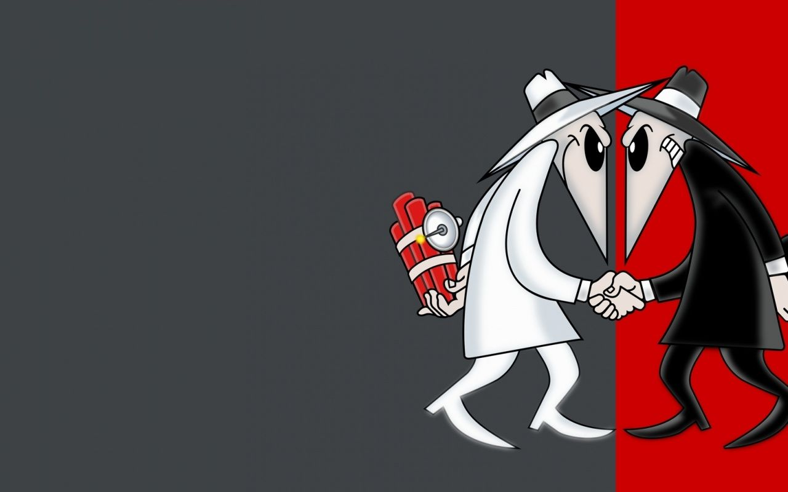
Limitation
This study has limitations in the following aspects.
First, the game only discusses the situation in that both sides can choose to use or not use a spy, but in reality, there are double-sided or multi-sided spies, more than one spy, their own spy betrays, and other complex situations. Discussing these situations can be very complicated because they cause an imperfect information game to become an incomplete information game. In this type of game, players worry about how much and how accurately others are getting information about them. As a result, not only will players choose according to the payoff, but there will be issues of manipulating information.

Slide 30
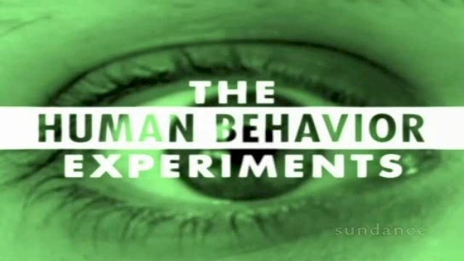
Limitation
Second, the study assumes that player strategy choices are based on knowledge of behavior and game theory, but no experiments have been conducted, so we cannot test the theory. During the experiment, data may appear that is different from the theory, or factors may arise that affect the player in ways that are not anticipated.

Slide 31
Thanks for listening!

Slide 32
Reference
Bibliography Niou, Emerson M. S., and Peter C. Ordeshook. 1994. “A Game-Theoretic Interpretation of Sun Tzu’s.” Journal of Peace Research 31 (2): 161–74. https://doi.org/10.1177/0022343394031002004.
Rapoport, Anatol, and Albert M. Chammah. 1966. “The Game of Chicken.” American Behavioral Scientist 10 (3): 10–28. https://doi.org/10.1177/000276426601000303.
Sunzi, and Michael Nylan. 2020. The Art of War. New York: W. W. Norton & Company.

